Slide 1
Military Construction in the Arctic
Lessons Learned and Future Challenges
Julie Mages, P.E.
611th Civil Engineer Squadron
1
Notes:
1

Slide 2
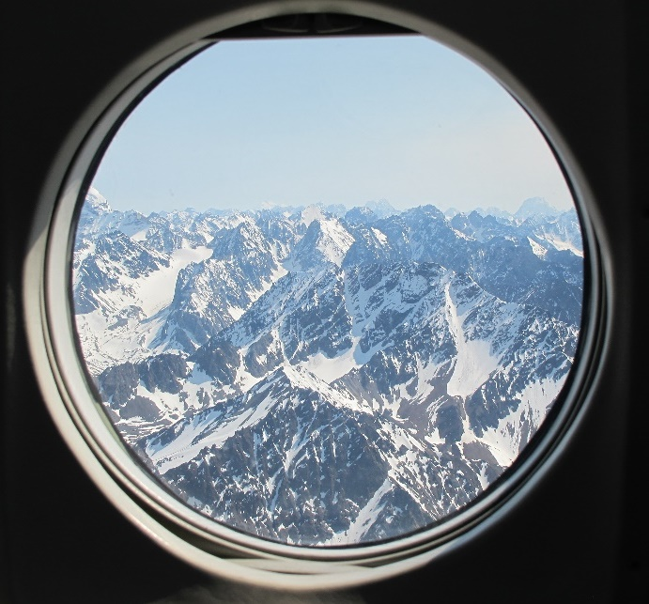
Overview
Our AOR
Alaska Radar Sites (ARS) & Eareckson Air Station (EAS)
Cape Lisburne and the Seawall Repair

Slide 3
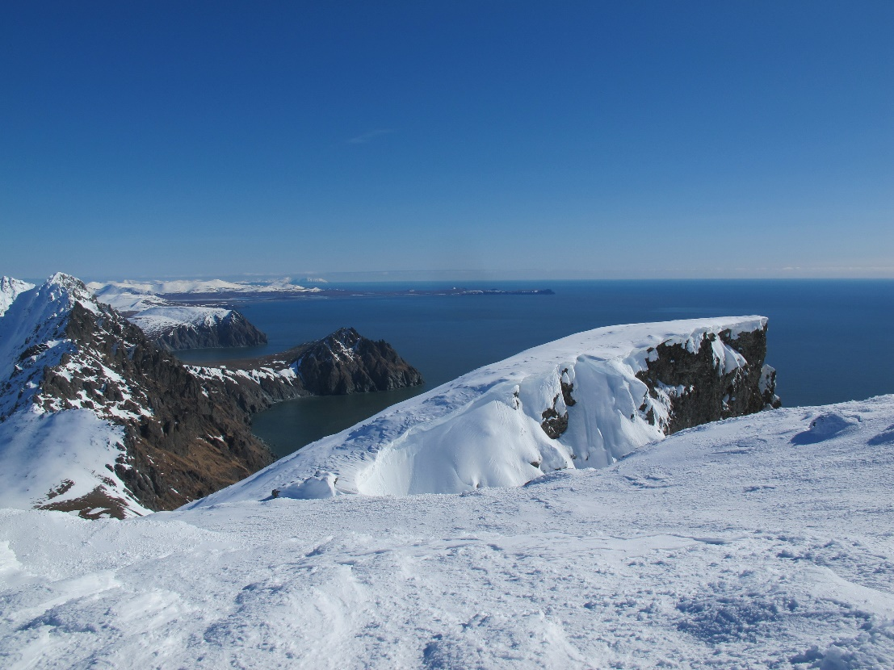
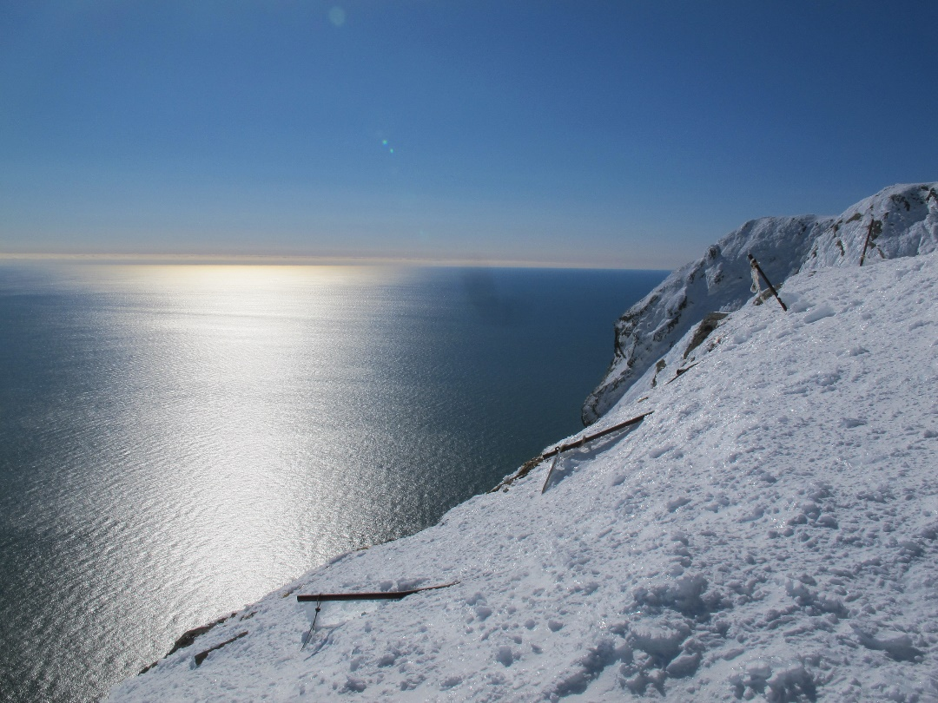
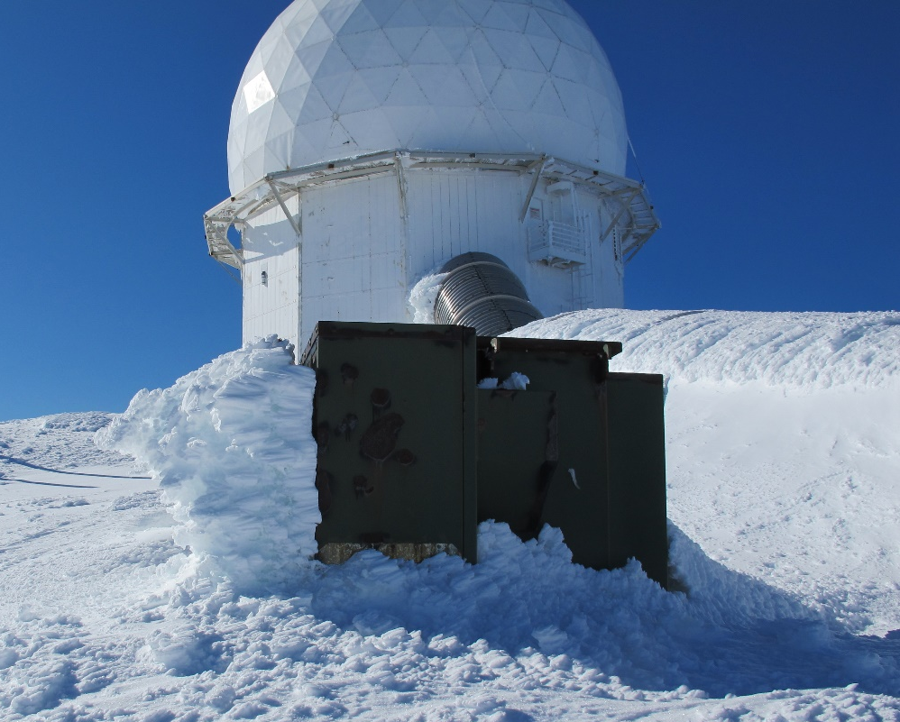
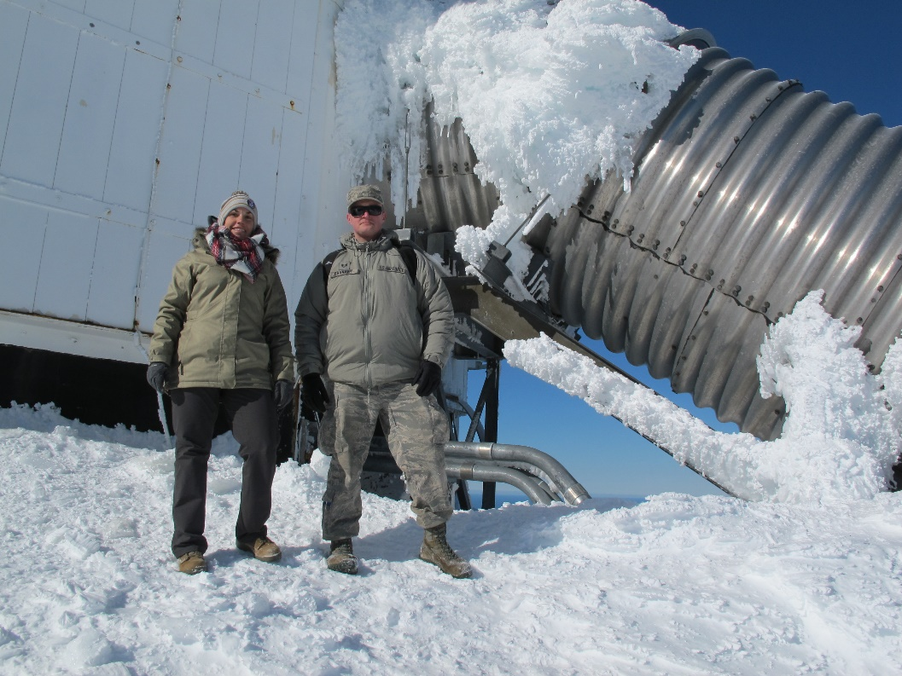

Slide 4
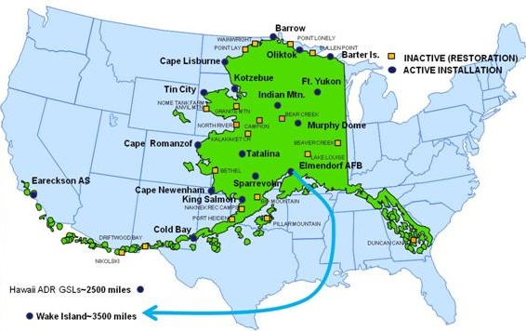
Area of Responsibility

Slide 5
Area Cost Factors
UFC 3-701-01
Location | Area Cost Factor
Cold Bay LRRS | 4.55
Eareckson AS | 4.55
Most ARS | 2.51-2.53
Murphy Dome | 2.25
* Cost adjustment factor to change from a common location cost to location-specific costs

Slide 6
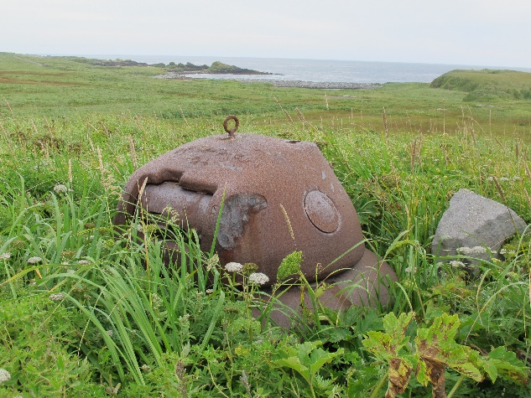
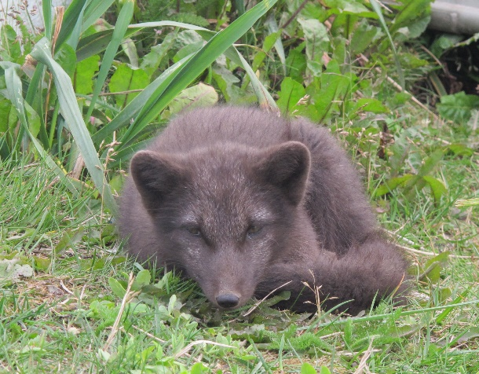
Eareckson Air Station

Slide 7
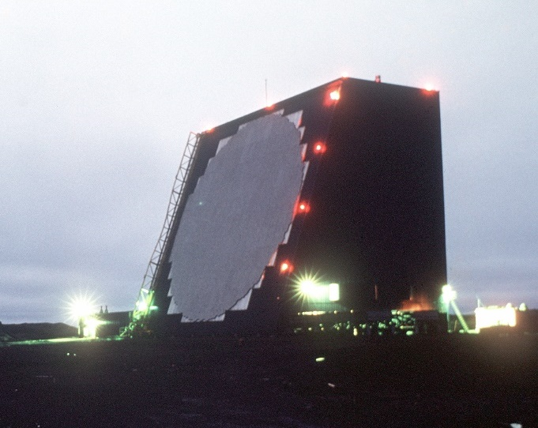
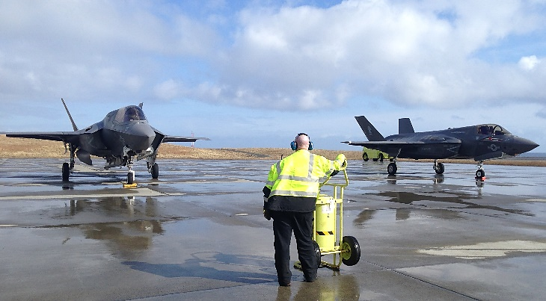
Eareckson Air Station (Shemya)
Key Mission Partners
  21 Space Wing: Space object tracking and intel for AFSPC, USNORTHCOM, AF ISR
  Missile Defense Agency: Long-haul, interceptor comm for USNORTHCOM and missile tracking
  10,000 ft runway
    Only emergency/weather divert airfield in 1,400 mile radius -- Air Bridge for Travel to/from Asia-Pacific
  Weather Challenges/Increased Costs
    Fuel Barge Delays, Flights to/from Cancelled...
    Aging Infrastructure
Critical Support for Ballistic Missile Defense Capability - Homeland Defense!

Slide 8
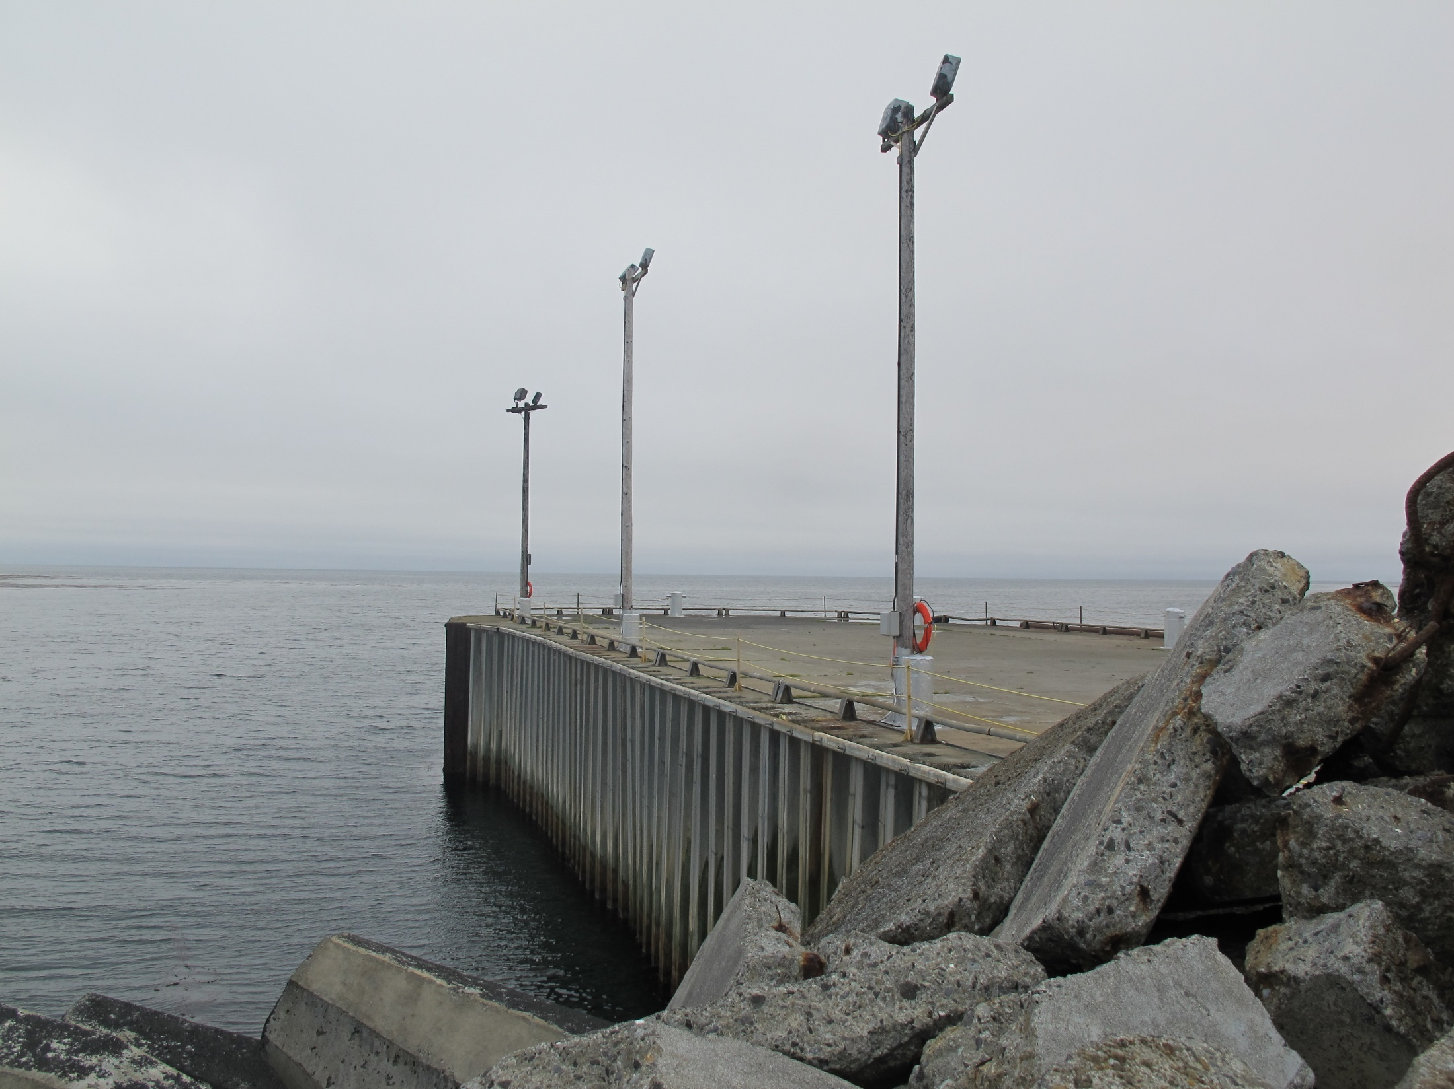
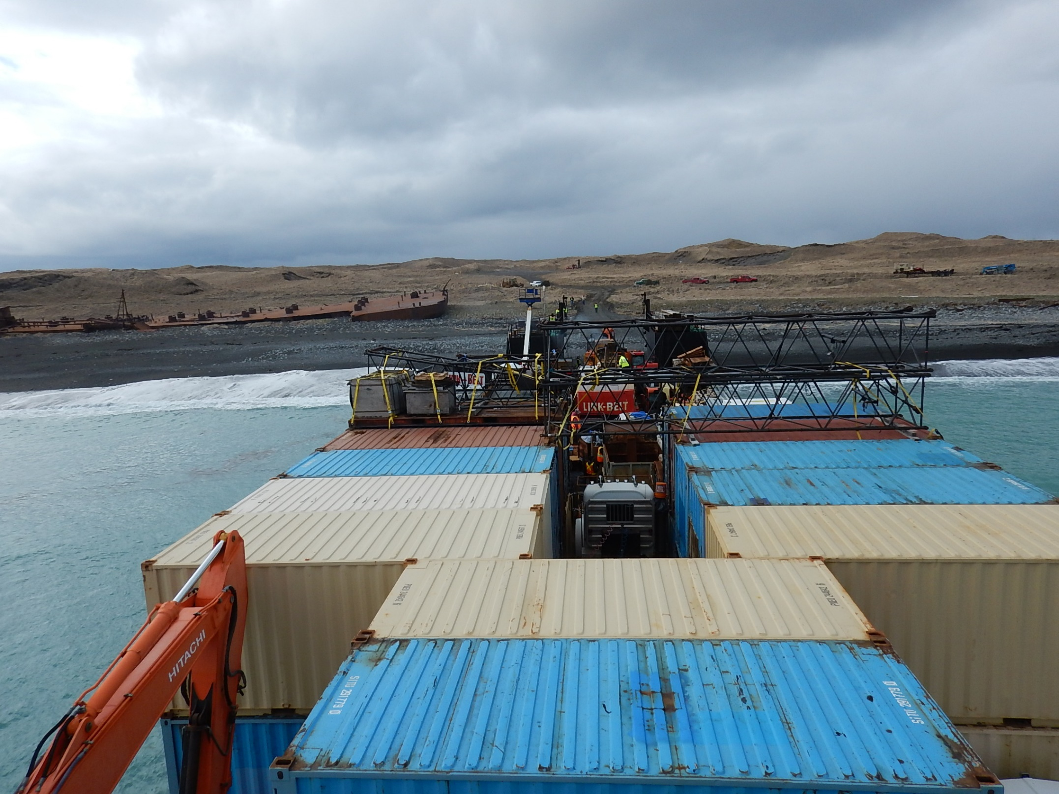
Weather and Logistics
Fuel barges to Eareckson usually have to wait 2-6 months to make delivery
  Fuel Pier exposed to weather/strict offloading requirements
Creative Solutions for offloading heavy equipment
  Beach Landing at a WWII ordinance disposal site
  USAF/ADEC and UXO Technician

Slide 9
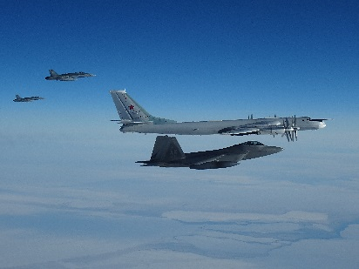
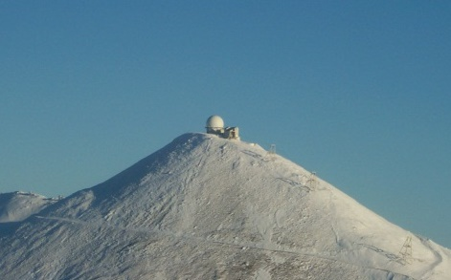
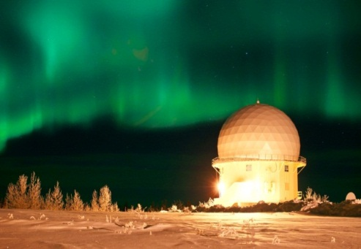
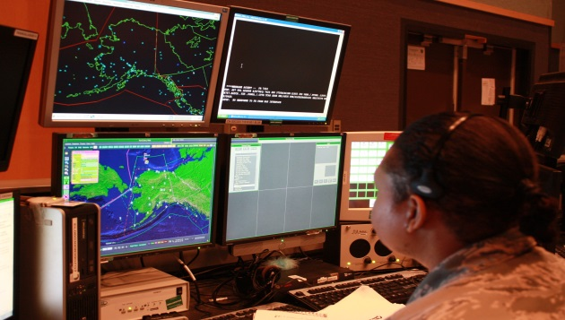
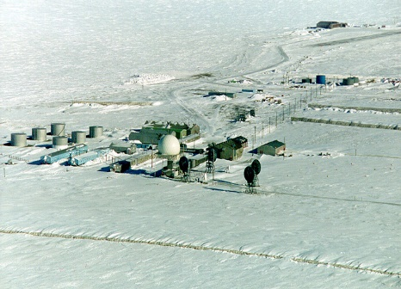
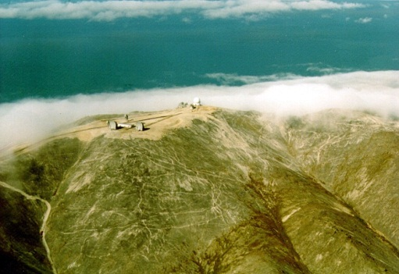
Alaska Radar System (ARS)
15 Long-Range Radar Sites
O&M via 10yr BOS Contract (ARCTEC)
Federal Aviation Agency Cost-Shares 12 Sites
Harsh Weather/Environment Create Unique Infrastructure and Logistical Challenges
Intercept by two USAF F-22s &
two RCAF CF-18s, 20 Apr 17
Tin City
Fort Yukon
169 Air Defense Sq
(Alaska ANG)
Barter Island
Barter Island
Cape Lisburne
Provide 24/7/365 Air Picture for Warning, Assessment, Command and Control Ensuring
Air Sovereignty of U.S. and Canada
Notes:
FAA Cost-Share Does Not Include Barter Island, Oliktok, and Cape Lisburne

Slide 10
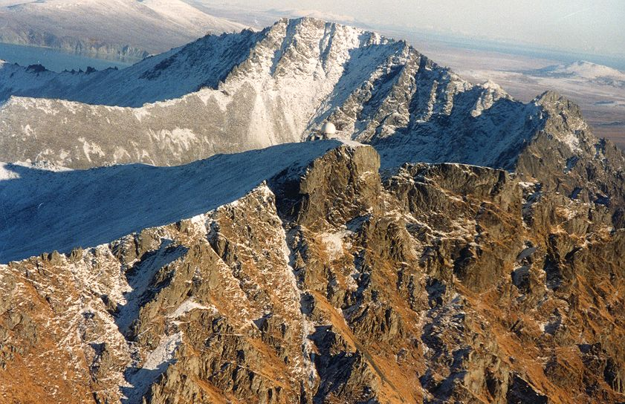
Cape Newenham LRRS

Slide 11
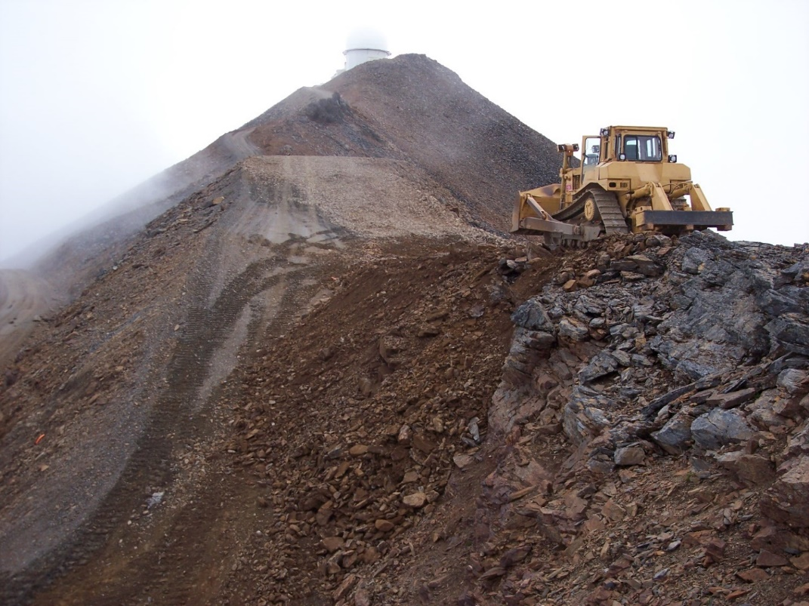
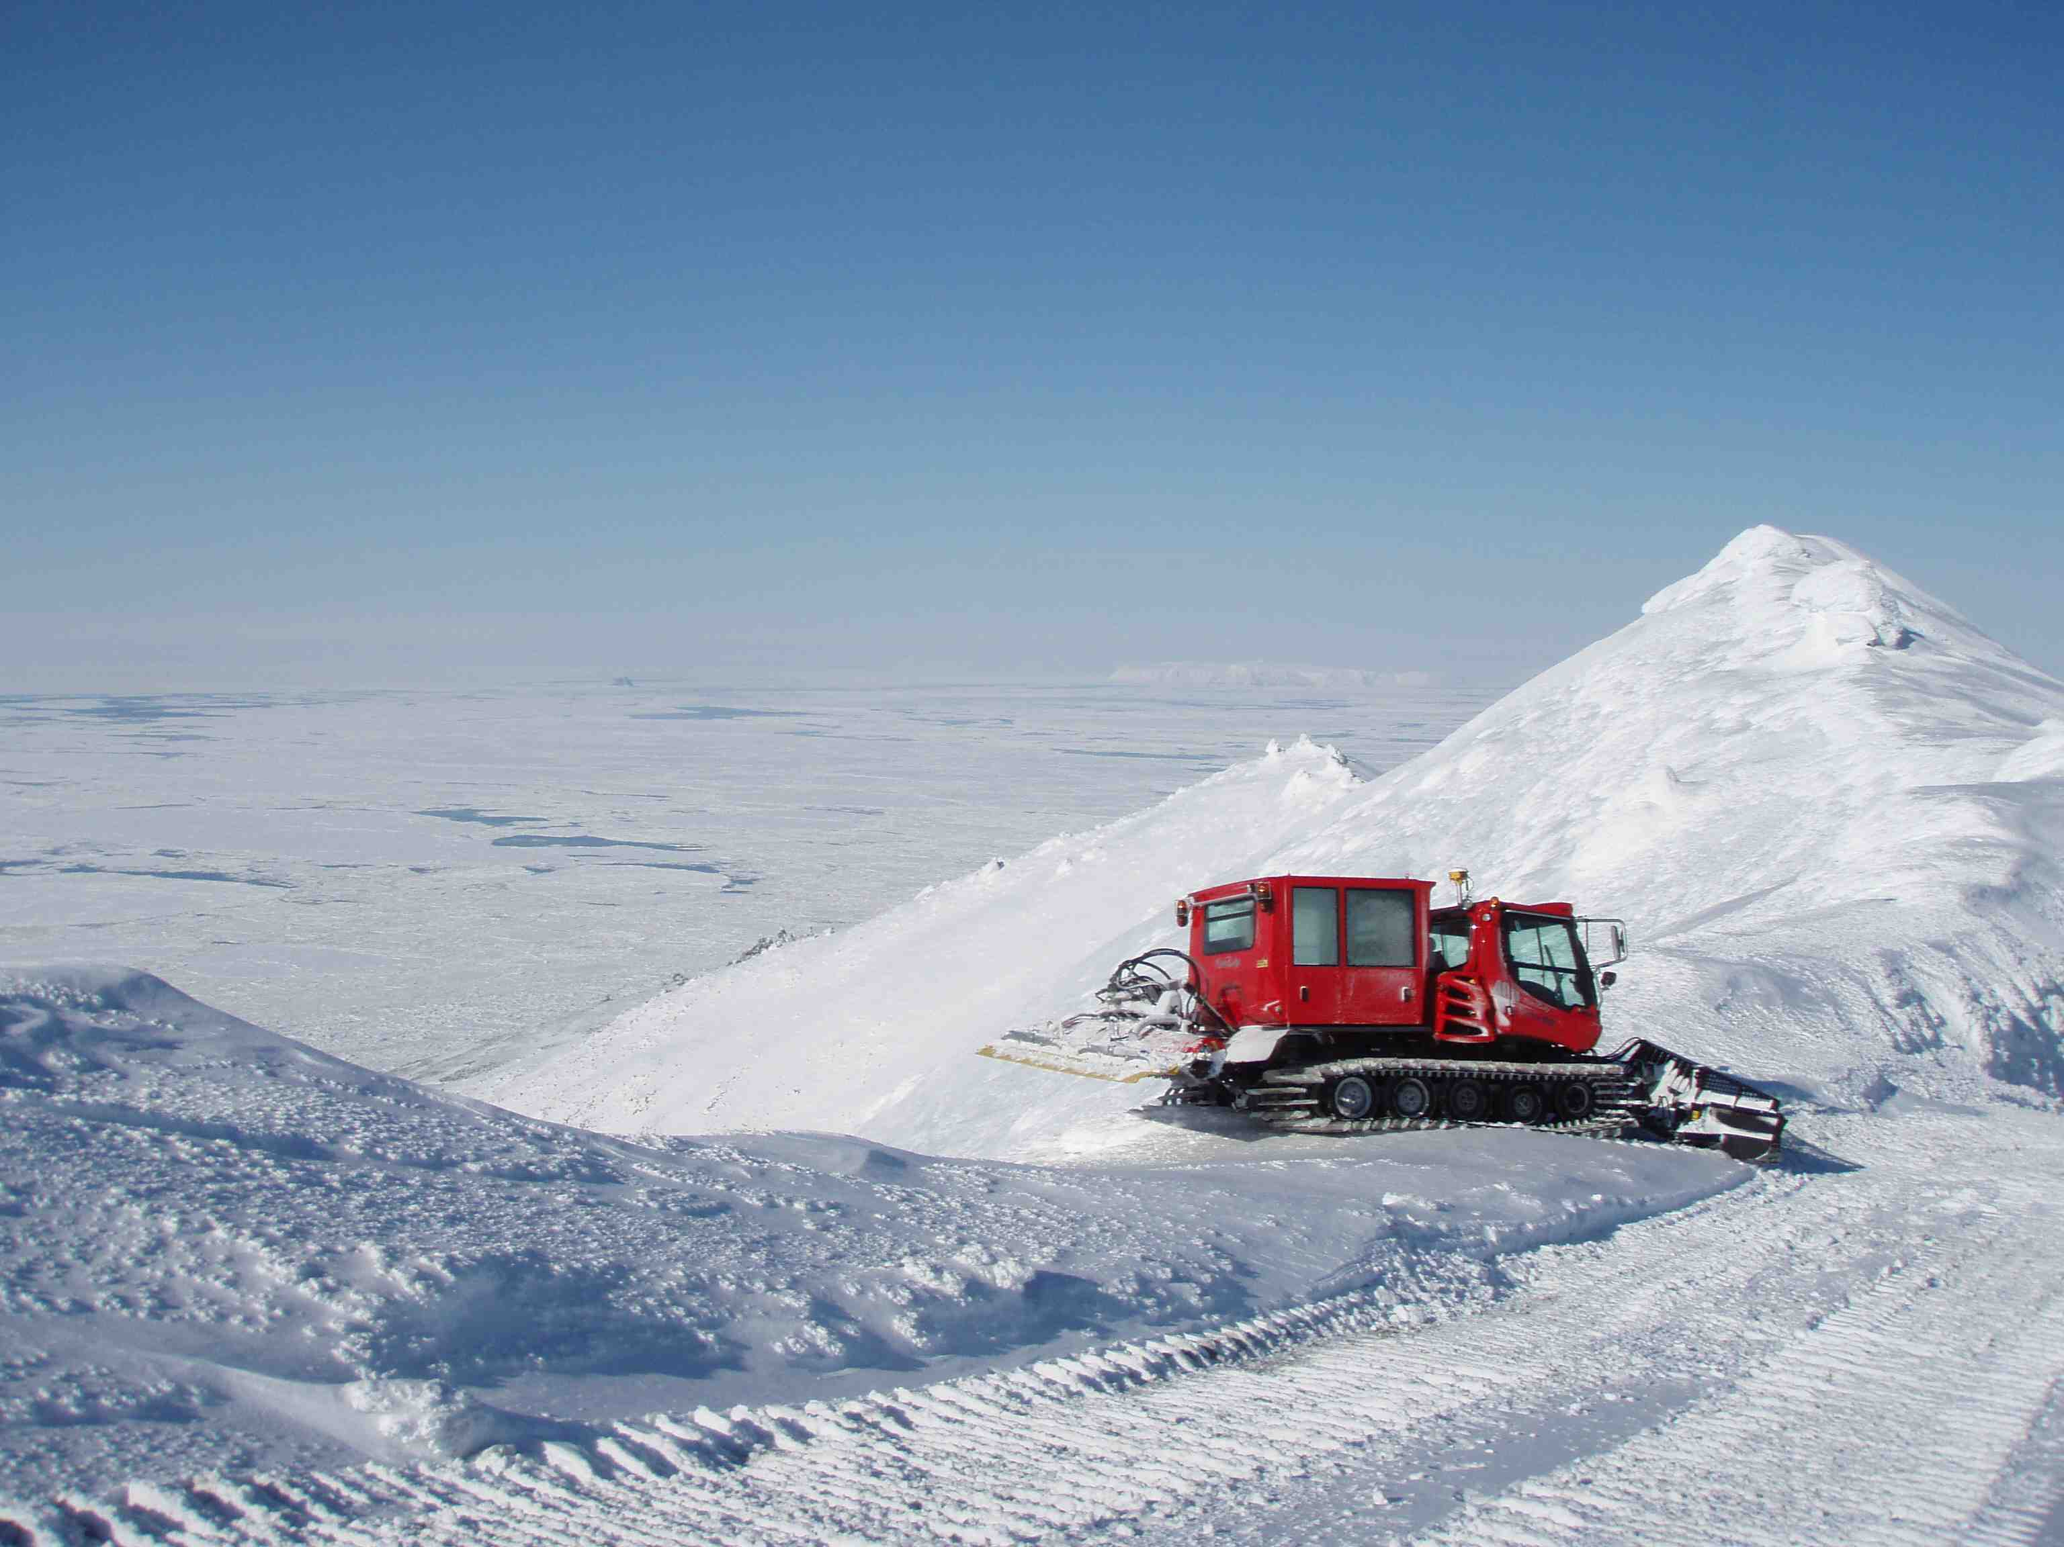
Road to Top Camp
Tin City Piston Bulley
Tin City Road Work

Slide 12
ARS by the Numbers
$4 Billion in Facilities, Equipment and Materiel
29,000 ft of Runways/4 Million ft² of maintained primary runway surface
59 miles of roads
44 Prime Power/Emergency Generators
Diesel and MOGAS Capacities > 1.8M gal
FPS-117 Long Range Radar/FAA Equipment & Radios
Indian Mountain LRRS

Slide 13
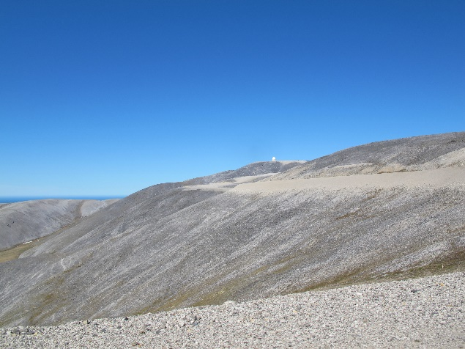
Challenges/Lessons Learned at the ARS Sites
Environmental Considerations
Weather and Logistics
Security

Slide 14
Environmental Conditions
Land Use Control Management
  Land use controls are supplementary to engineering controls for short-term and long-term management to prevent or limit human and environmental exposure to hazardous substances, pollutants, or contaminants.
Environmental Restoration
Marine Mammals
Endangered Animals
Cultural Resources
Tribal Relations
Migratory Birds

Slide 15
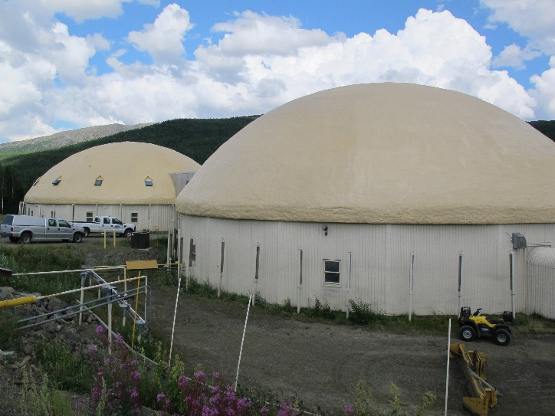
ARS Logistics
Transportation – primarily airlift
  Airfield sites, Ft Yukon supported by military, and contract air
  Indian Mountain, Sparrevohn can only be supported by air
  Village sites supported via commercial air
Other Modes
  Murphy Dome, Oliktok supported via road system
  Coastal sites, Tatalina, Ft Yukon supported by sealift and river barge
Influences
  Major influence is weather
  Few commercial carriers; expensive
Annual Resupply for Fuel
  Village sites purchase fuel locally

Slide 16
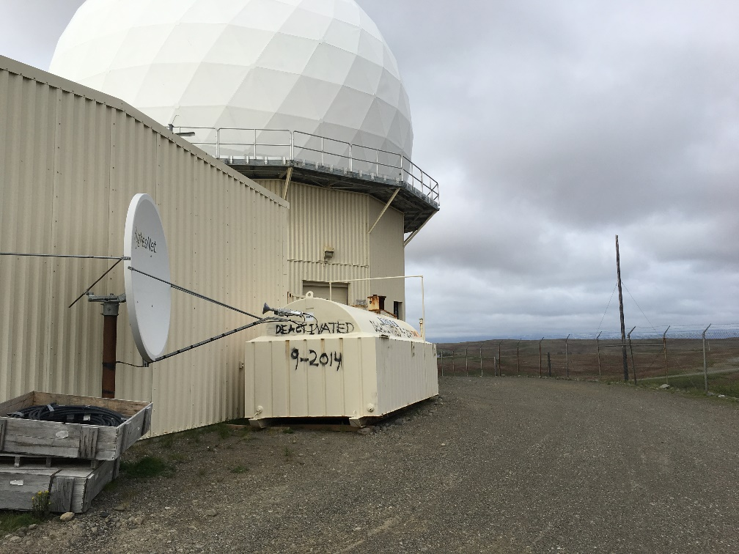
Security
All people going to/from any site need background checks
Facilities have different levels of security
Must have a reason to be on site

Slide 17
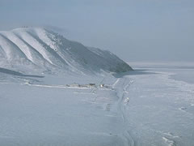
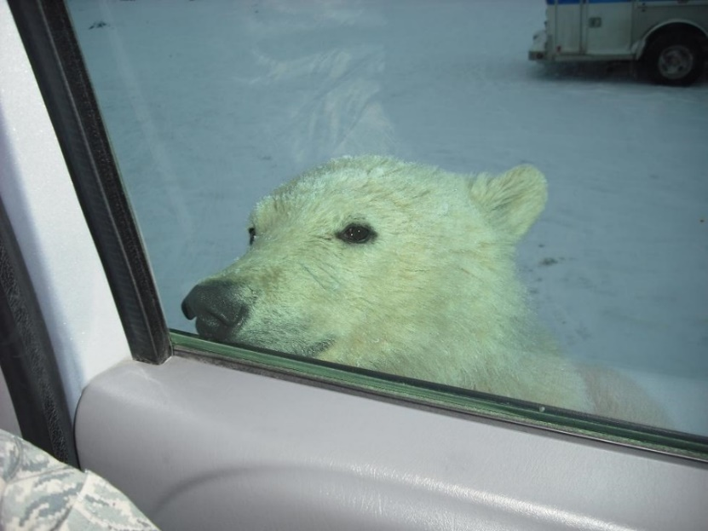
Cape Lisburne, LRRS

Slide 18
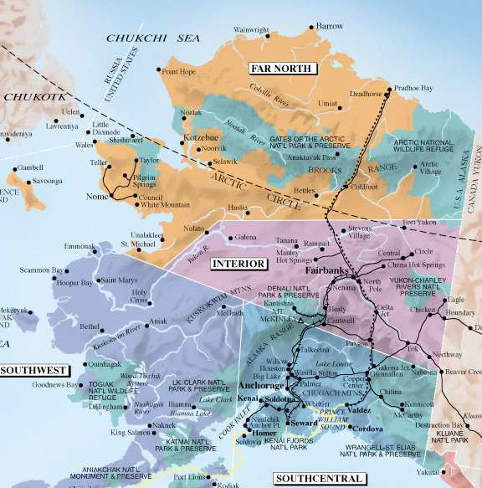
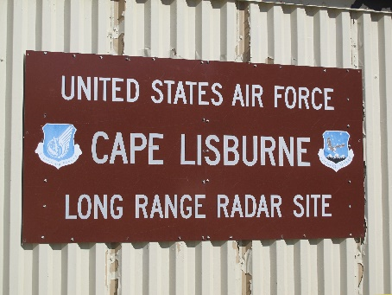
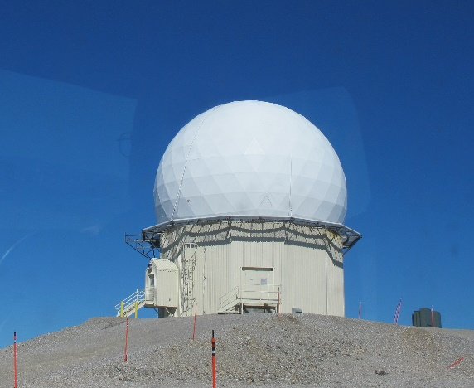
Cape Lisburne
  706 miles NW of JBER
  Within the Alaska Maritime
  National Wildlife Refuge
  Nearest community:
    Point Hope, 25mi
Cape Lisburne LRRS

Slide 19
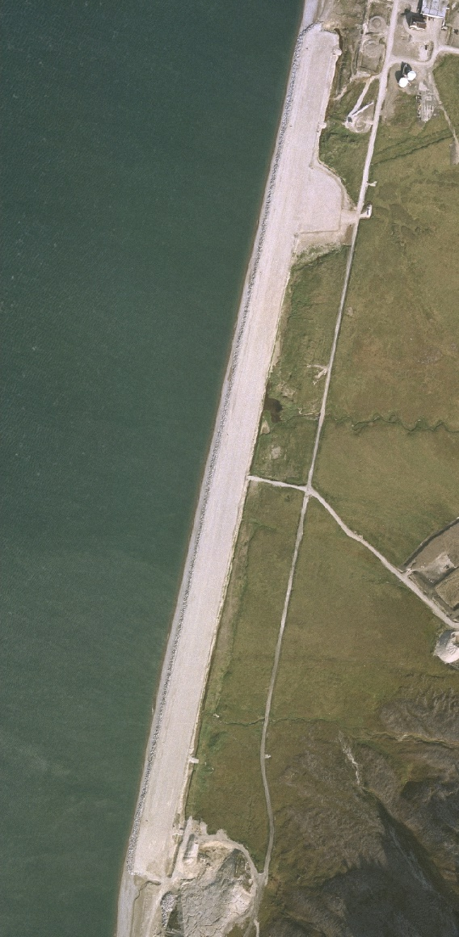
Airfield & Seawall
Airfield
  Built 1952
  One gravel surface runway
  4,100 ft X 150 ft
  Only means of accessing the site in the winter months
  Relocation not feasible
Seawall
  Essential to the airfield runway
  Natural slope armored with boulder rip-rap
  Protected by near shore sea ice in fall/winter/spring
Seawall

Slide 20
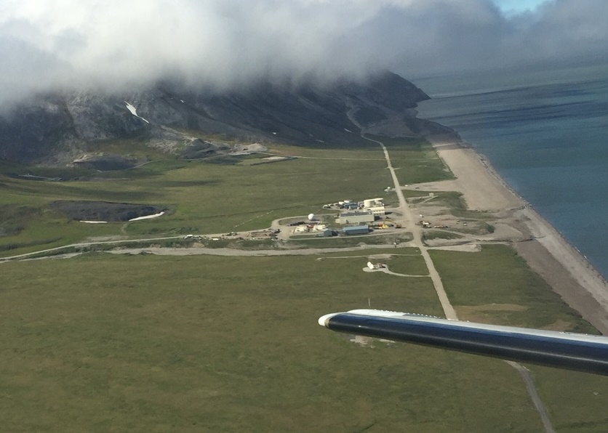

Slide 21
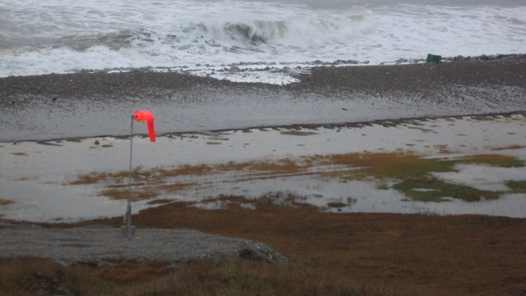
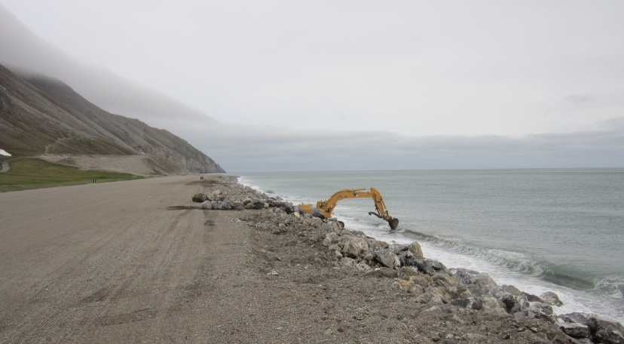
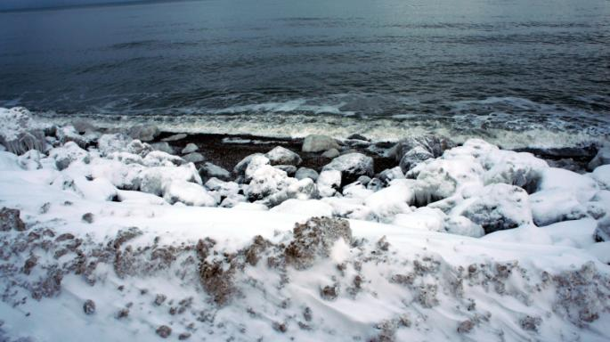
Timeline of Events
Shorter winters and less sea ice accelerating coastal erosion
Major storm September 2012
Exhausted existing quarry
New storm November 2013
June 2014 USACE surveys/studies
Construction Awarded to Orion Marine Construction Sep 2015, $41M
September 2012 – waves on runway
Summer 2014 – ARCTEC repairs seawall
Summer 2014 – ARCTEC repairs seawall
November 2013 – hole in seawall
Notes:
Discuss alternatives
- Dolos, sheet piles, relocation of runway, spot repair
Runway critical to mission

Slide 22
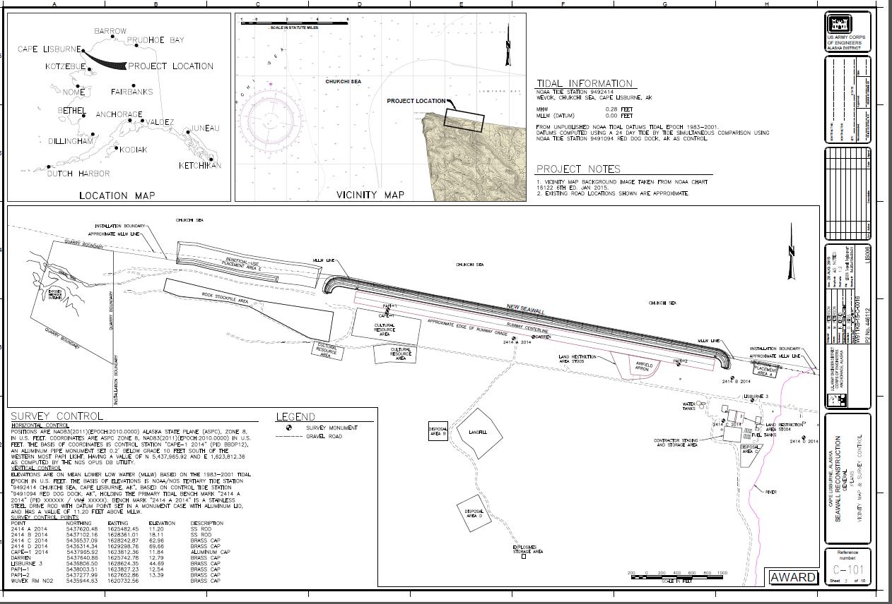

Slide 23
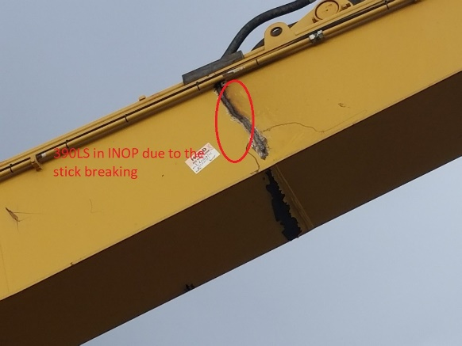
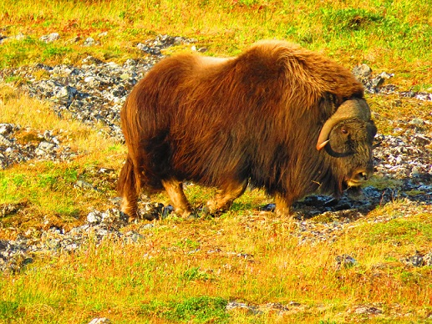
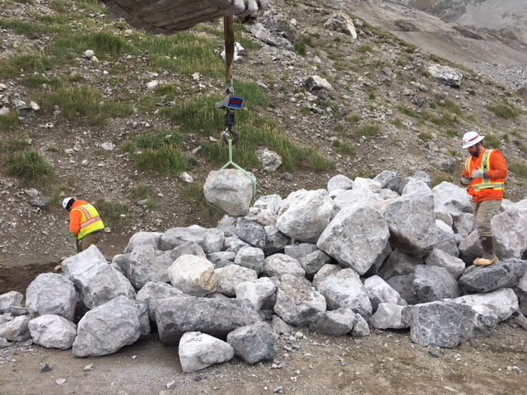
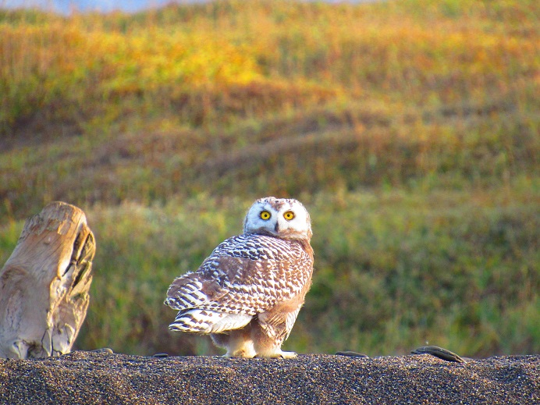
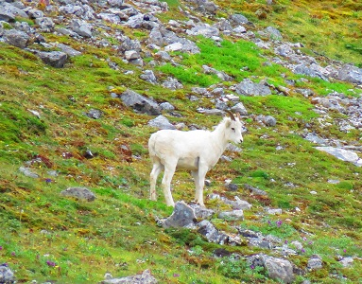
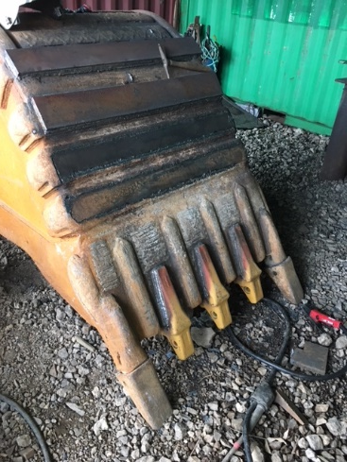
Construction Challenges
Materials/Fuel Delivery
Quarry/Explosives Requirements
Construction Season
Mancamp/Sewage Treatment
Wildlife

Slide 24
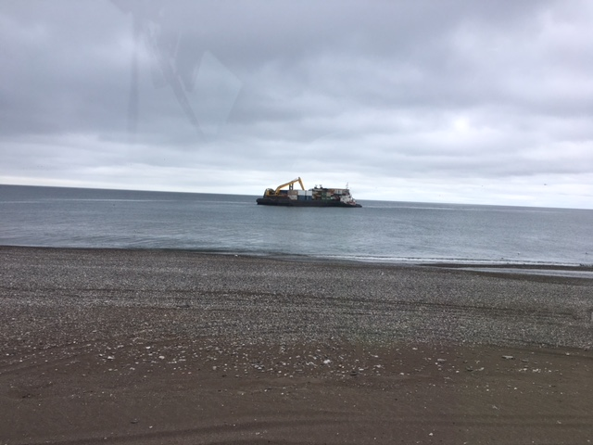
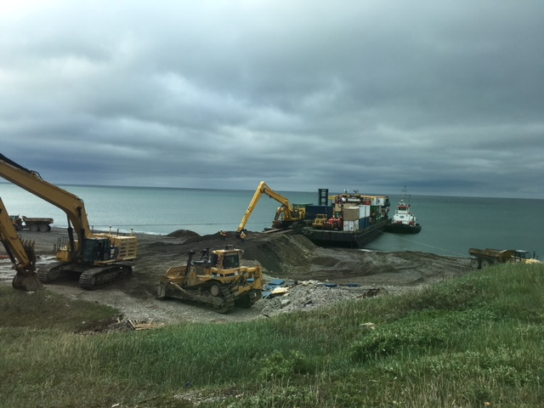
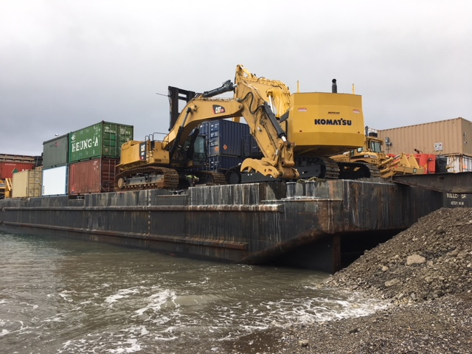
Barging and Logistics
Beach Landings

Slide 25
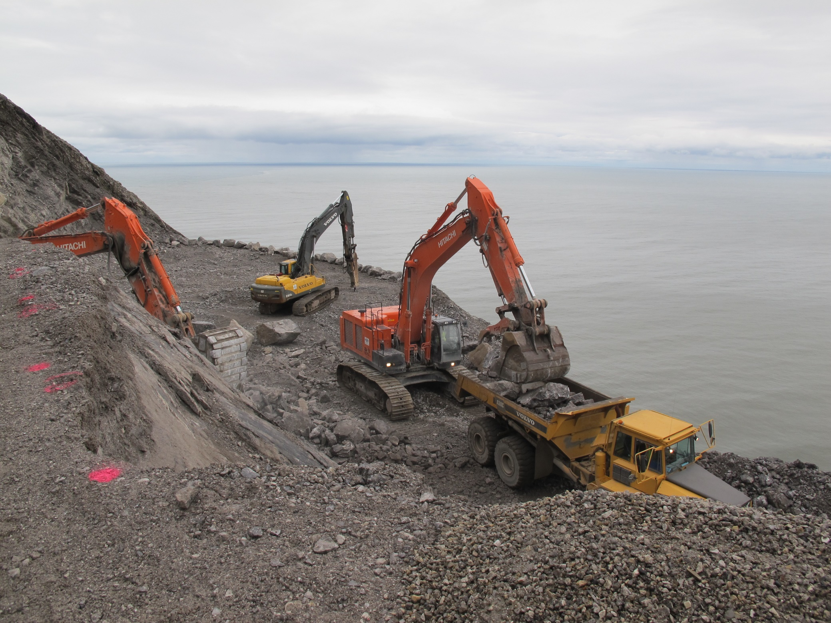
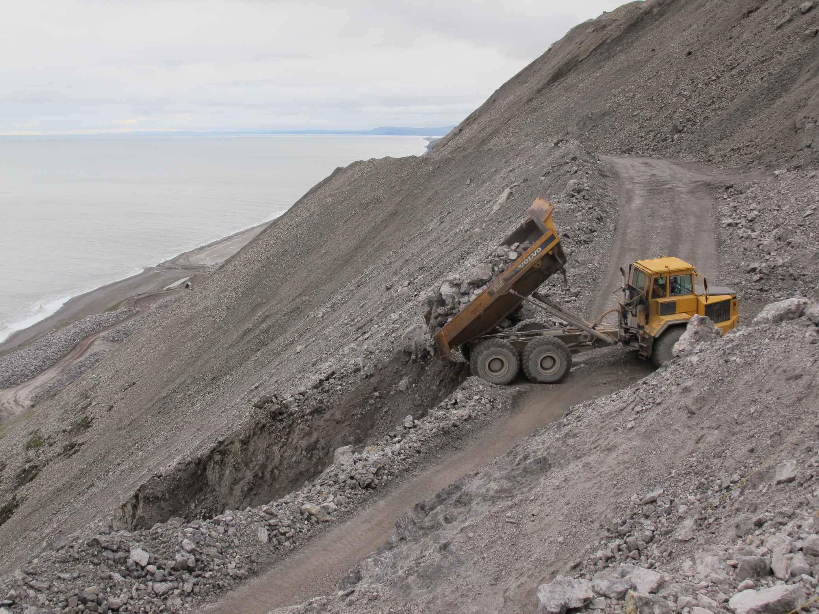
Quarry Operations
Notes:
Quarry operations require significant quantities of explosive materials, which are stored on Air Force property under an approved waiver while a final DDESB storage plan is developed. The storage location meets Q-D requirements from the radar and bottom camp, but hazards utility lines that support the radar. The location cannot be changed and the utilities cannot be buried without impacting wetlands or creating further hazards. The contractor has encountered challenges blasting difficult rock and has requested increased storage.

Slide 26
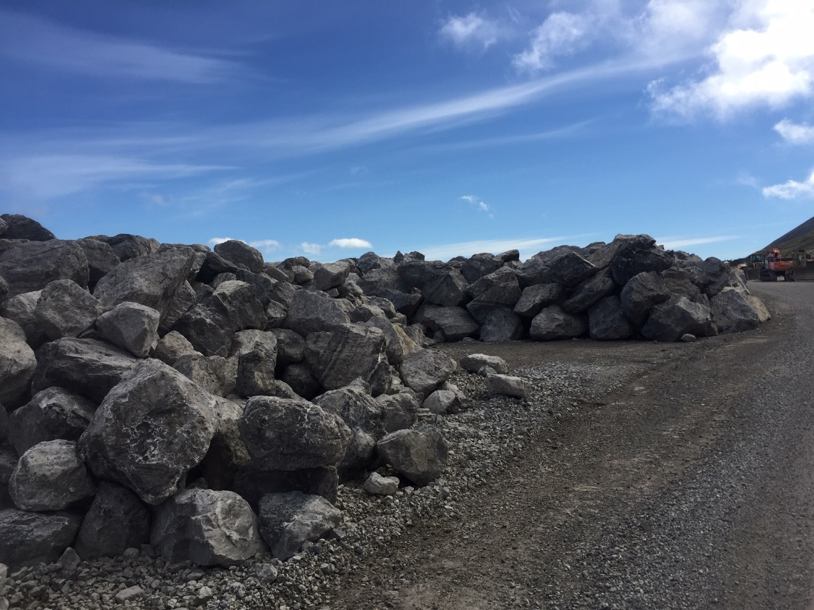
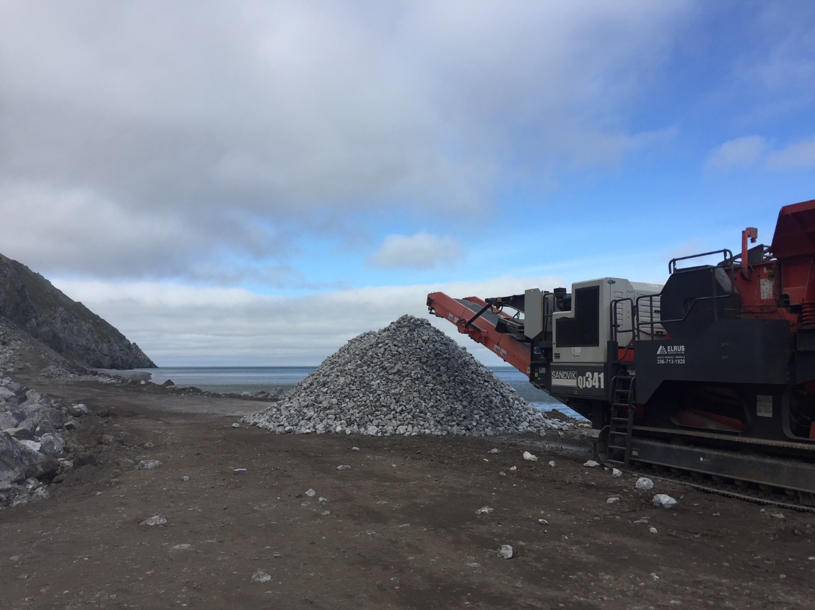
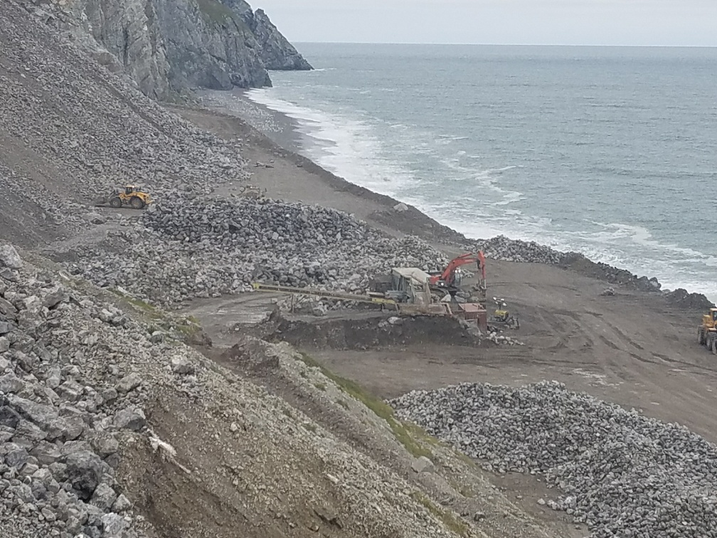
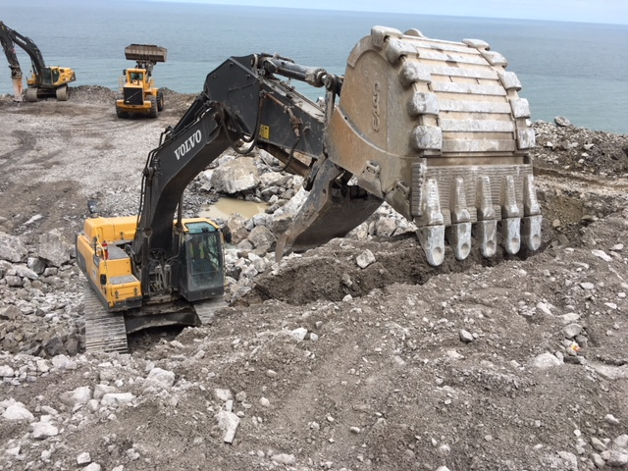

Slide 27




Slide 28




Construction Seasons
Notes:
-Sea Ice
-Daylight

Slide 29

Limited Beds/Kitchen Space
- Sewage Treatment (Life Water Engineering)
- Entertainment
- Food: Preservation/Preparation/Serving
- Bear Proof
- 16 available beds in main facility
- Other people need to use the site

Slide 30

Fuel and Explosives
- Critical to project schedule
Fuel: $4.92/gal, need +320,000 gal per construction season, temporary storage, delivery schedule

Slide 31



Slide 32




Food Control/Management
General Awareness
Bear Interaction Management Plan
No Harassment Policy

Slide 33

Walrus Monitoring

Slide 34




TIME and $$$

Slide 35
BUT AREN’T THEY CUTE?

Slide 36


Seawall: Before and After
Construction Challenges
Notes:
Wave Action/Storms
Rock and Equipment
Redundancy
Air Traffic and Schedule

Slide 37

Conclusion
Expensive
Understand your problem
Know your location
Changing Climate
Environmental Preservation
Success comes from detailed logistics and planning

Slide 38

Questions?

